Slide 1



Weed Detection using Semi-Supervised Learning

Slide 2
Problem Statement
The task is to develop a weed detection model using semi-supervised learning. We are given:
200 labeled images of sesame crops and weeds.
2. 1,000 unlabeled images of similar content.
3. 50 test images with annotations.
The goal is to train a model that can accurately identify and localize weeds, and show clearly how the performance is increased by leveraging unlabeled data.
Weed detection in agricultural fields is a significant challenge for precision agriculture.

Slide 3

Semi-Supervised Model
A semi-supervised learning model leverages both labeled and unlabeled data to improve learning efficiency. It is useful when labeled data is scarce or expensive to obtain.
Labeled Data: Small dataset with input-output pairs (e.g., images with weed annotations).
Unlabeled Data: Large dataset without labels (e.g., images without annotations).
Learning Objective: The model learns patterns from labeled data and refines its understanding using unlabeled data.
Advantages:
Reduces reliance on expensive labeled datasets.
Improves model generalization and performance.

Slide 4
Our Strategy :
Train YOLO8vx model on training set.
This serves as our base line model.
2. Generate Psudeo-Labels for unlabled images using this model.
This allows our model to leverage its perfomance using the large unlabeled data.
3.Fine-Tune the model using both labeled and psudeo-labeled images.
We take advantage of the pre-trained YOLO8vx model to train our model
efficiently.
4.Evaluate the Model using the testset.
We check the perfomance of our model using different metrics.

Slide 5
YOLO Format
The YOLO format is used for object detection, where each annotation defines the bounding box and class of an object in an image. The format typically consists of a .txt file for each image, with each line representing one object using the following structure:
<class_id> <x_center> <y_center> <width> <height>

Slide 6
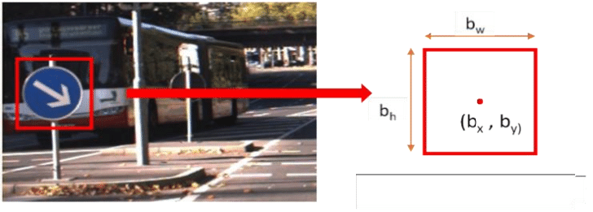
Example of YOLO format
This is represented as 0 bx by bw bh

Slide 7
YOLO8vx
What is YOLOv8x?
A cutting-edge object detection model, building on YOLOv8 with an anchor-free approach and
improved feature fusion for high accuracy.
Key Features:
High Accuracy and Speed: Optimized for real-time detection with improved inference.
Enhanced Feature Extraction: Uses CSPDarkNet53 for superior object representation.
Anchor-Free Detection: Simplifies training and boosts precision.
Advanced Object Localization: Uses Decoupled Head and CIoU loss for better bounding boxes.
Multi-Task Capabilities: Supports detection, segmentation, and classification.
Why YOLOv8x?
Balances efficiency and accuracy for high-performance detection.
Ideal for applications in agriculture, robotics, autonomous vehicles, and surveillance.
Scalable for edge and cloud deployment, with optimizations for real-time AI tasks.

Slide 8
Architecture of yolo8vx
1. Backbone (Feature Extraction)
Uses CSPDarkNet53 with a Focus layer to process images more efficiently.
Extracts important features from input images using convolutional layers.
2. Neck (Feature Fusion)
Utilizes PAN (Path Aggregation Network) + FPN (Feature Pyramid Network).
Ensures information from low-resolution (contextual) and high-resolution (detailed) features are fused properly.
3. Head (Prediction)
Uses Decoupled Head, separating classification and bounding box regression.
The anchor-free approach improves object localization and speed.ragraph text.

Slide 9
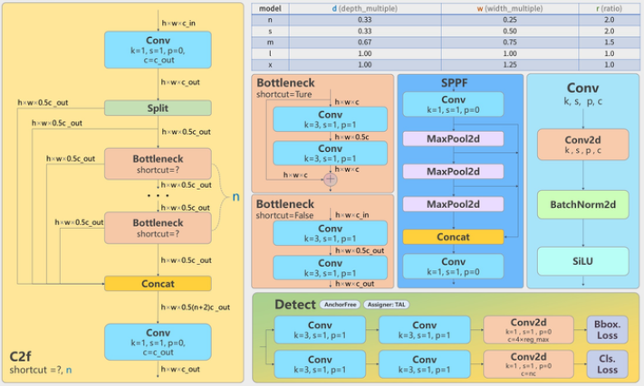

Slide 10
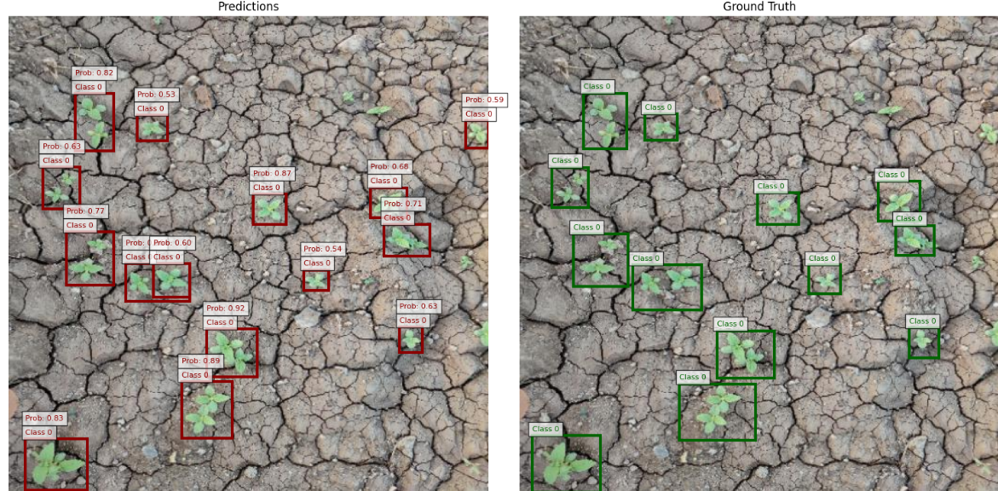
MODEL PREDICTIONS
Our model predicts better than ground truth.

Slide 11
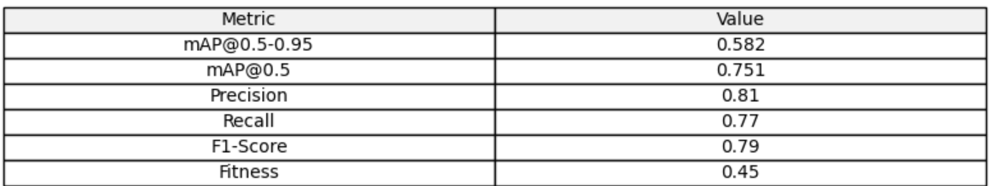
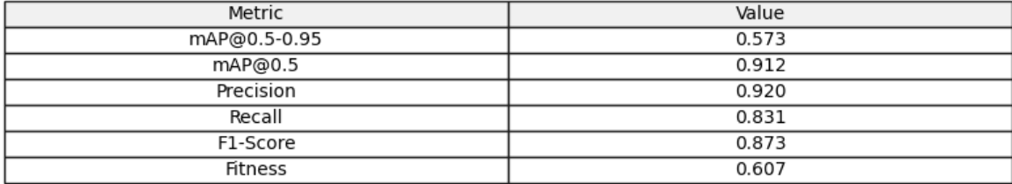
Results
Baseline Model
Final model

Slide 12
Future Prospects
Combining Multi-Spectral and Thermal Imaging
Current model relies on RGB images, but additional sensor modalities can improve accuracy.
Use near-infrared (NIR) and hyperspectral imaging to detect weeds beyond the
visible spectrum.
Integration of thermal cameras to differentiate weed species based on heat signatures.
Integration of sensor fusion models to combine RGB, depth, and multispectral data.
Integration with Smart Farming & Precision Agriculture
Our model can be integrated into precision agriculture systems to enhance farm productivity and optimize resource usage.
Potential applications:
Automated weed-mapping systems using drones or ground robots.
Smart irrigation systems that adapt water distribution based on weed density.
AI-driven herbicide spraying systems to reduce chemical overuse.

Slide 13
Thank You

